Slide 1

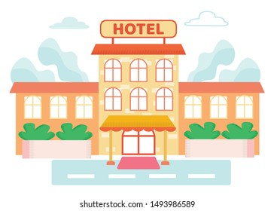
The hotel review analysis

Slide 2
Presentation Highlights
Problem Statement & Objective
Detailed Design Description
Experiment and Results
Creative Approaches
Shortfall Identification
Questions

Slide 3

Problem Statement & Objective
Generally, people have a usual tendency to go through the reviews of a hotel before booking for a stay, but one might look at 10-15 reviews and not more to get a general idea about the hotel.
This project intends to provide a quick comparison between two hotel by taking account of the reviews received so far, which is used to understand which hotel is better than the other.

Slide 4

Detailed Design Description
Step 1: Data Extraction
Step 2: NLP Pre Processing
Step 3: Binary Conversion
Step 4: Association Rule
Step 5: Finding Max Support
Step 6: Compactness Pruning
Step 7: Redundancy Pruning
Step 8: Polarity

Slide 5
Step 1: Data Extraction
Sources | Hotels reviews are considered from Makemytrip.com, goibibo.com
Which City | Goa
What we scraped: | Reviews, Ratings, Hotel Names
Libraries and Tools Used: | Python, Microsoft Excel, Chrome Extension ‘Web Scraper’
No. of reviews scraped: | 6047

Slide 6
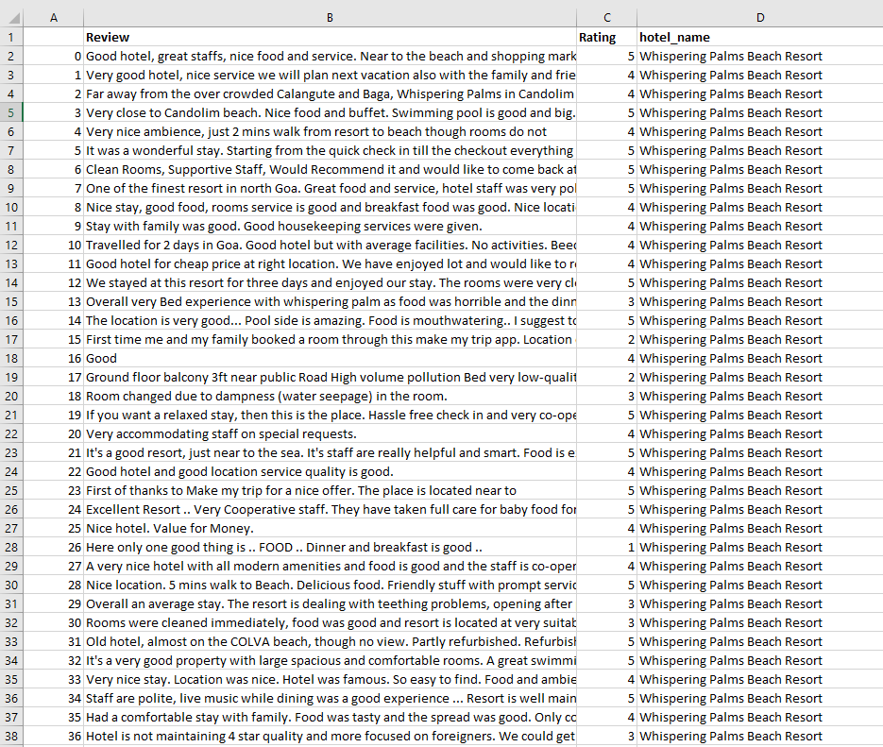
Snapshot of Data Extraction

Slide 7
Step 2: NLP Pre Processing
Procedure 1: Remove Punctuation
Procedure 2: Converting Text into Lower Case
Procedure 3: Remove Extra Space
Procedure 4: Remove Emoji
Procedure 5: Tokenization
Procedure 6: Remove Less Than Two Words
Procedure 7: Common Noun Tag
Procedure 8: Converting Text into Singular Text

Slide 8
Procedure 1: Remove Punctuation (!"#$%&\'()*+,-/:;<=>?@[\\]^_`{|}~)
‘Money’ → Money
Procedure 2: Converting Text into Lower Case
Money → money
Procedure 3: Remove Extra Space
‘ Worth for Money ‘ → ‘Worth for Money’
Procedure 4: Remove Emoji
The resort is very good 😍 → The resort is very good
Breakfast is not available 😇 → Breakfast is not available

Slide 9
Procedure 5: Tokenization
The resort is good, breakfast is good. Staff service is too slow → [[ The resort is good breakfast is good], [Staff service is too slow]]
Procedure 6: Remove Less Than Two Words
The resort is good → The resort good
Procedure 7: Extracting Common Noun Tag
The resort is very good → resort (Common Noun)
Procedure 8: Converting Text into Singular Text
Houses → House, Cities → City

Slide 10

Why Nouns?

Slide 11
Step 3: Binary Conversion
Example:
N N N N
The resort is very good. Breakfast is fine. No response from the reception team.
 | Resort | Breakfast | Response | Reception
The resort is very good | 1 | 0 | 0 | 0
Breakfast is fine | 0 | 1 | 0 | 0
No response from the reception team | 0 | 0 | 1 | 1

Slide 12
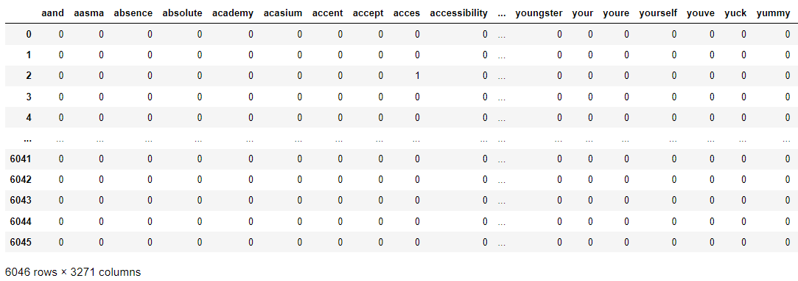
Snapshot of Binary Conversion

Slide 13
Step 4: Association Rule
What is Association rule mining ?
What is Support and confidence ?

Slide 14
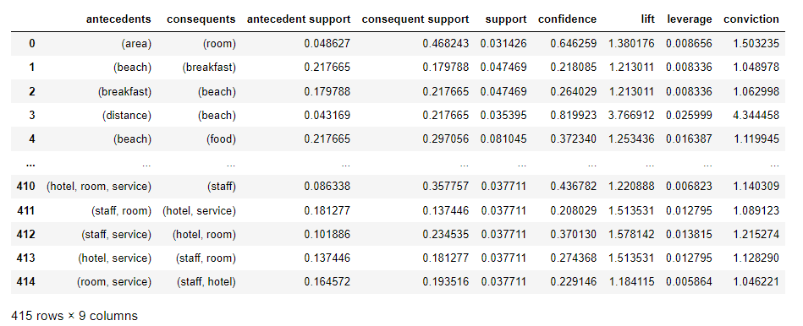
Snapshot of Association Rule

Slide 15
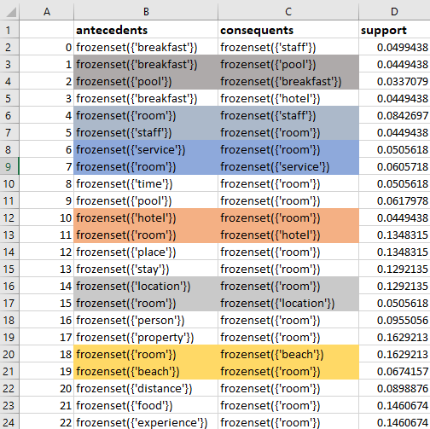
Step 5: Finding Max Support
Here we are trying to find the max support value for different feature as well as, we are trying to remove duplicate values like(resort ,room / room , resort )Which were present in antecedents and consequents.

Slide 16
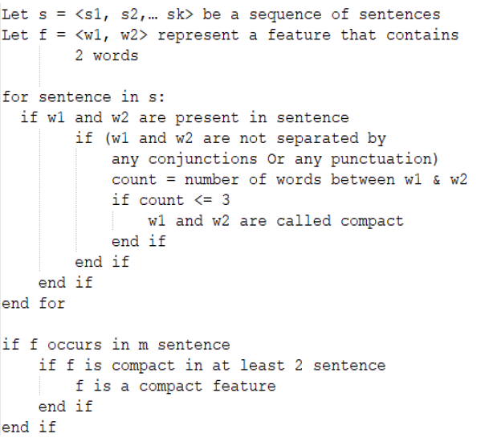
Step 6: Compactness pruning

Slide 17
Example for Compactness Pruning
Feature :[Hotel, Room]
‘Only the room cleaning uncle was good rather than other all of the staff was a bit annoyed I know on what but the room and facility was awesome good pool nice hotel clean room beautiful room.’ - Compact Feature
‘We reached hotel at midnight nice room but bad smell inside the room.’ – Compact Feature
‘this hotel has nice big spacious room.’ – Not Compact Feature

Slide 18
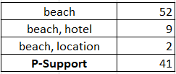
Step 7: Redundancy Pruning
This method is used to eliminate those single feature who has no meaning in a sentence by itself . This is done by calculating the p-support of the feature.
P-support is the number of the feature repeats in a paragraph by itself without considering the superset of the feature.
For Example For The feature Beach We can see the count of the subsets of ‘Beach’ , and the total count of beach in the reviews.so the psupport of the feature beach would be, (52-(9+2).

Slide 19
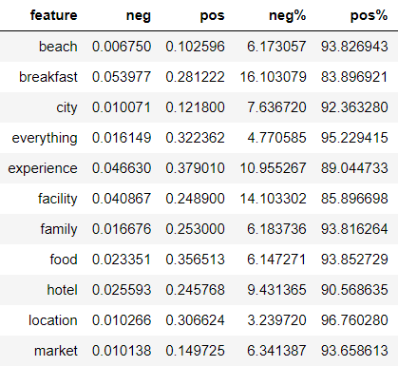
Step 8: Polarity
POS% = (POS/POS+NEG) *100
NEG % = (NEG/POS+NEG) *100

Slide 20
Results
https://hotelcompapp.herokuapp.com/

Slide 21
Shortfall Identification
Future Scope:
We have used single feature noun & in future we can scale it up to 2 feature model.
Now we're able to compare two hotel at a time but it is scalable to 3 hotel comparison at a time.
Limitation :
Lack of resource & Lack of computing power

Slide 22
CREATIVE APPROACH

Slide 23
Conclusion

Slide 24
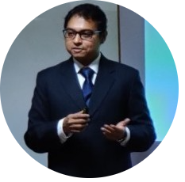
Mentor
PROF. GOURAB NATH

Slide 25





Our Team
Yogesh Babu
Vishwak Balaji
Neha Afreen
Lalit Kumar
Shameel Zeshan

Slide 26

Thank You

Slide 27

Questions

